Slide 1
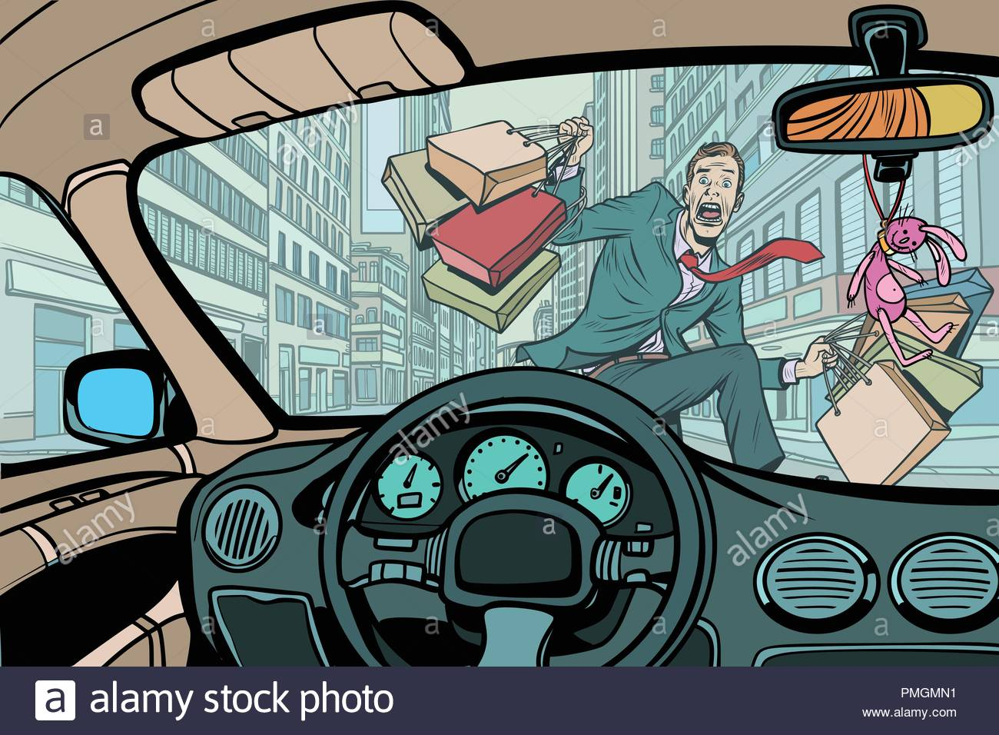

Traffic Accidents in Mexico
Team: Pandroits
Jésica Edith Tapia Reyes
Carlos Herrera Sosa

Slide 2
Agenda:
Motivation
Questions
Databases
Data Cleanup & Exploration
Holidays Vs Regular days
Models
Test
Questions

Slide 3
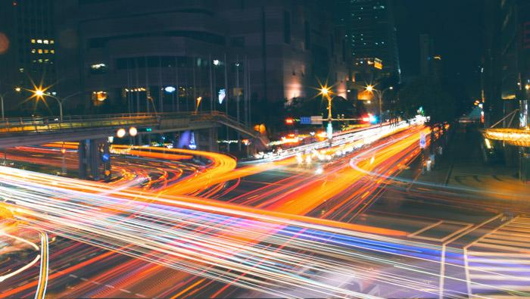
Agenda

Slide 4
...Are the traffic accidents a threat during holidays?
...Do car accidents increase during the holidays?

Slide 5
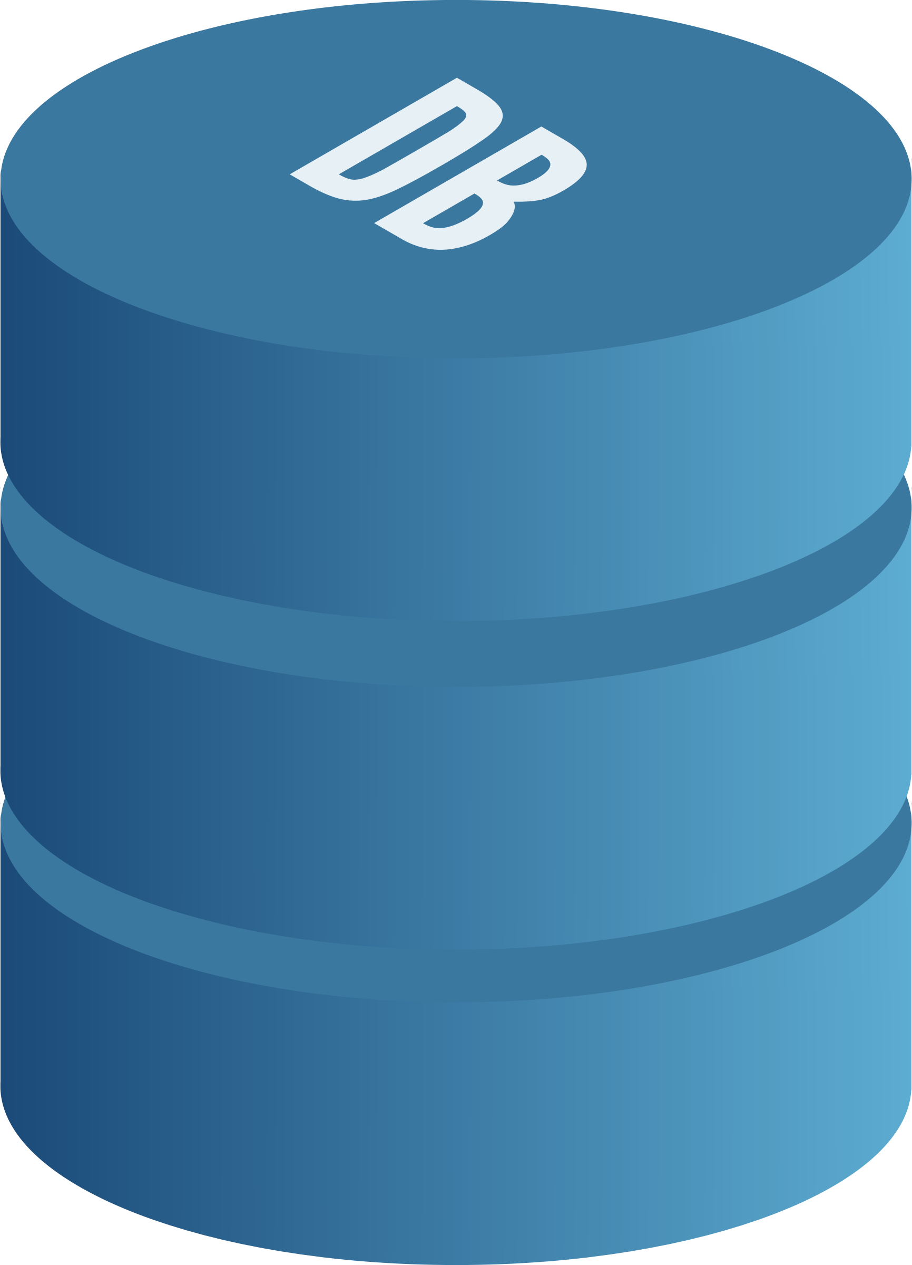
Databases:
Base Nacional Accidentes from INEGI (2014 - 2019) ¹ → 1,872,072 rows x 42 Columns
Incidentes viales reportados por C5 (2014 - 2019)² → 1,126,256 rows x 17 Columns
Directorio Estadístico Nacional de Unidades Económicas →(DENUE 2014 - 2018) 1207128 x 40 Columns
Source: 1→ https://www.inegi.org.mx/programas/accidentes/?ps=Microdatos 2→ https://datos.cdmx.gob.mx/explore/dataset/incidentes-viales-c5/table/
3→https://www.inegi.org.mx/app/descarga/

Slide 6
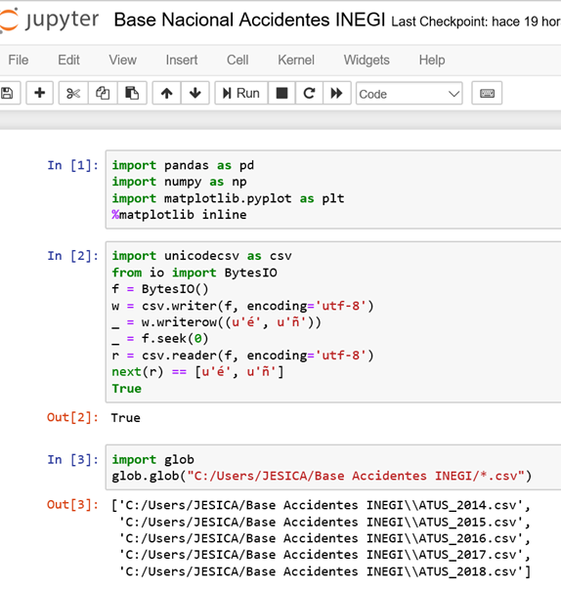
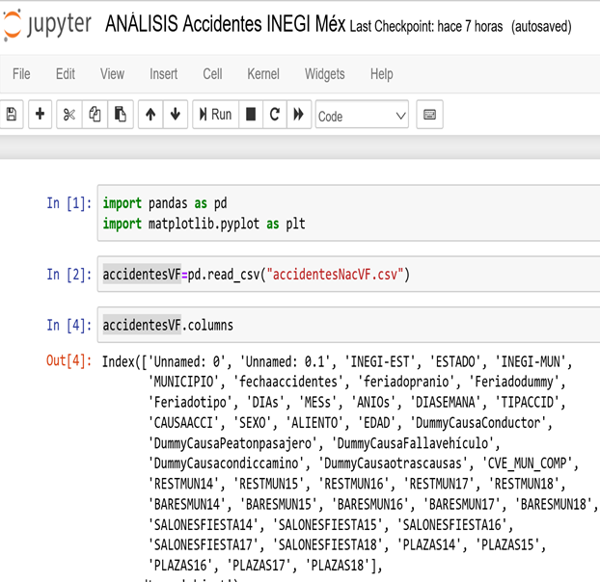
Databases:

Slide 7
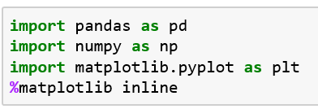
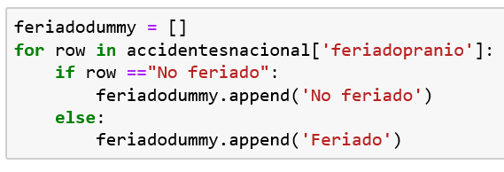
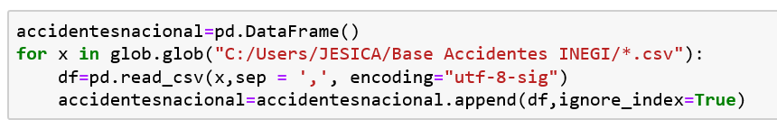
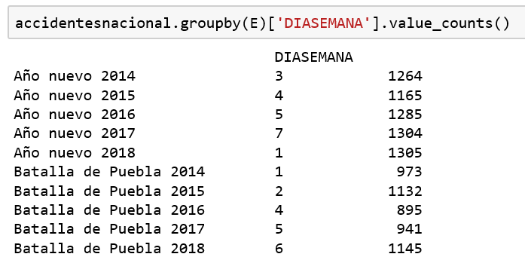
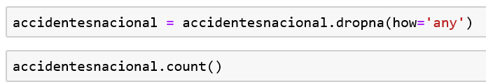
Cleanup:

Slide 8
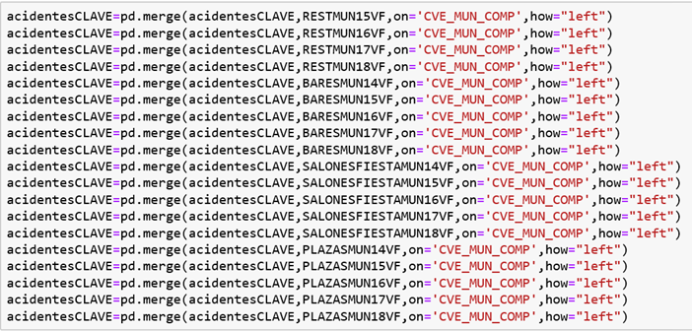
Merge:

Slide 9
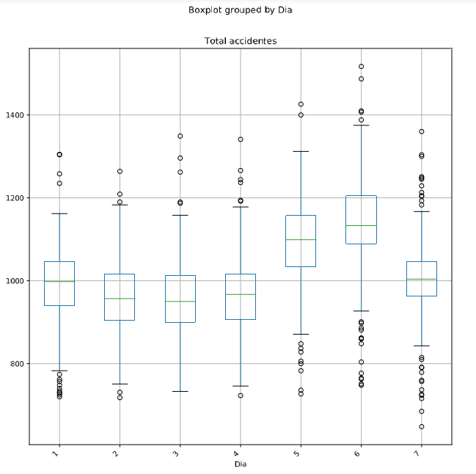
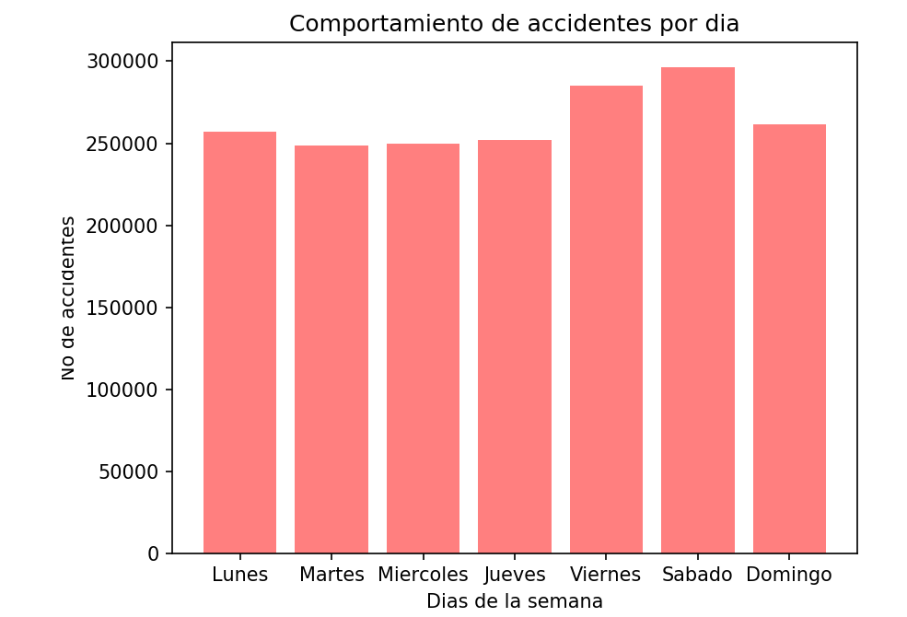
Days:

Slide 10
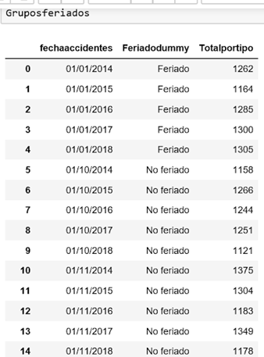
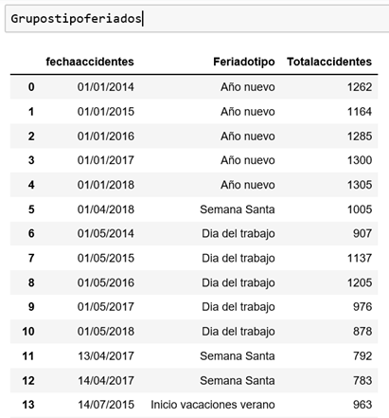
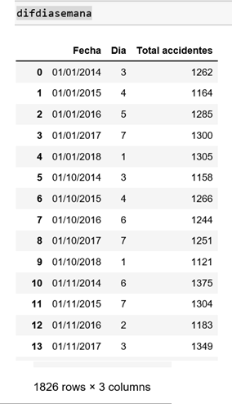
Data Frame
1. Holyday of Vs Not
2. Types of holidays
3. Week Days
Note: Holidays = Every day off including Christmas / Holy Week / National Day, etc.

Slide 11
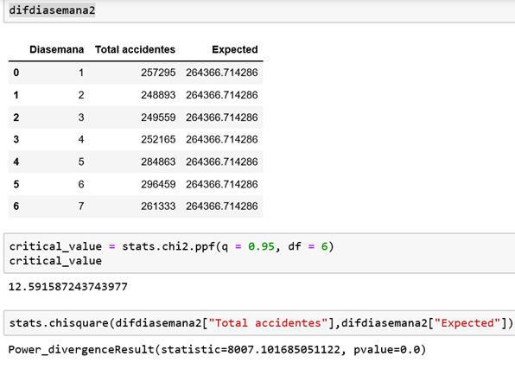
Tests: if p value is low...
1. Chi Test - Week Days

Slide 12
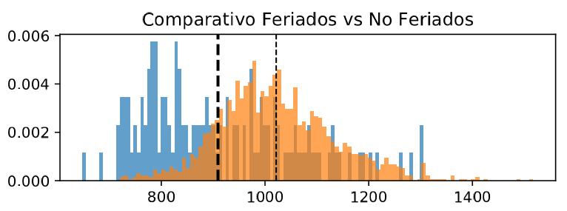
Tests:

Slide 13
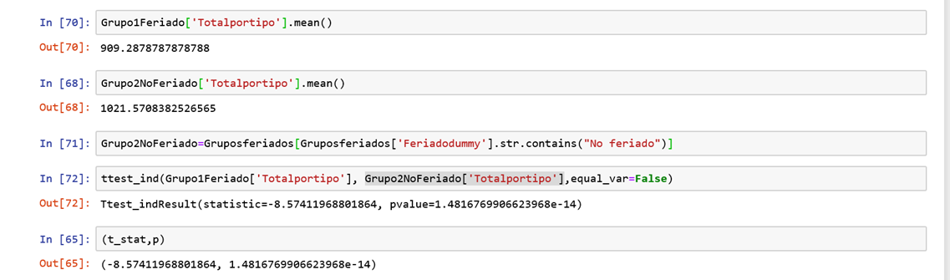
Tests: if p value is low...
2. T Test - Median Holyday of Vs No

Slide 14
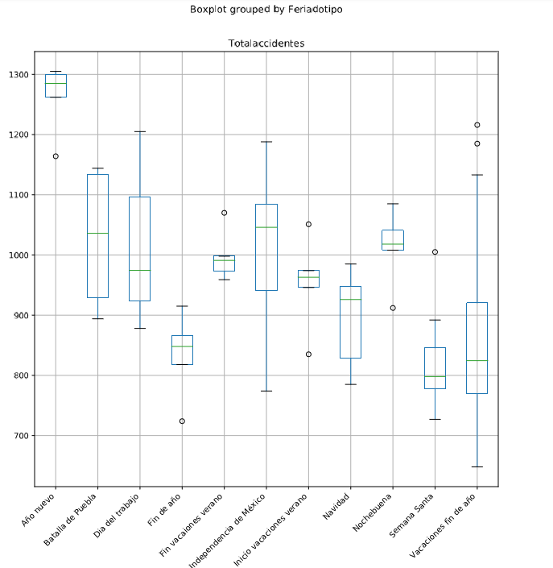
Tests feriado x tipo:

Slide 15
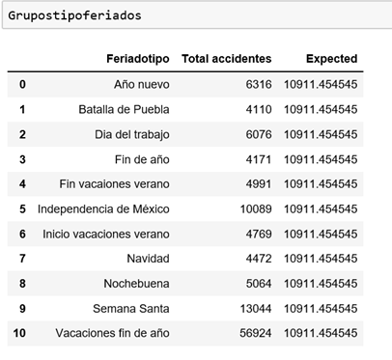
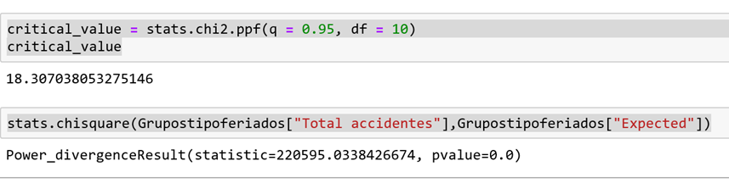
Tests:
3. Chi Test - Types of holidays

Slide 16
Result:
Guess what…
Holidays do not drives accidents
We are safe.

Slide 17
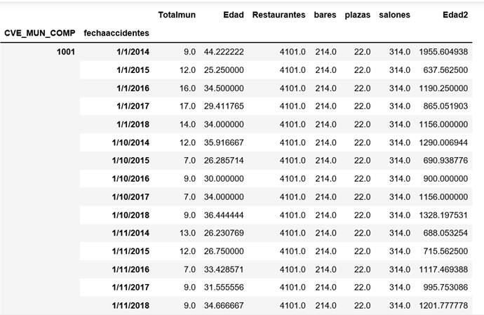
But...How can we explain accidents?

Slide 18
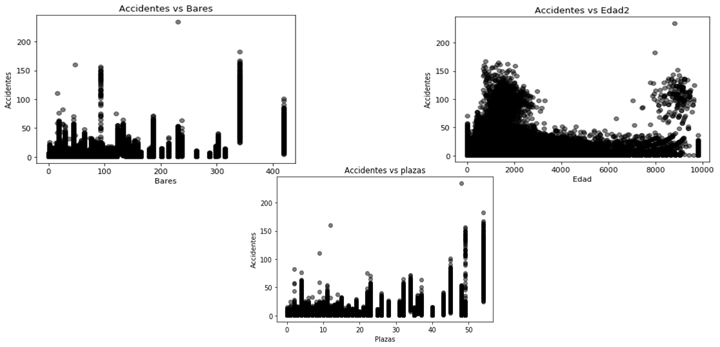
But...How can we explain accidents?

Slide 19
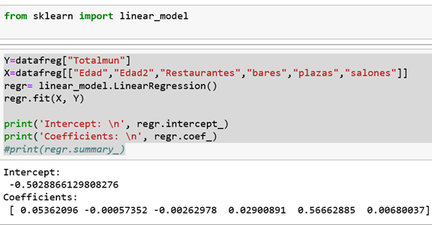
We explore an statistical model to explain accidents

Slide 20
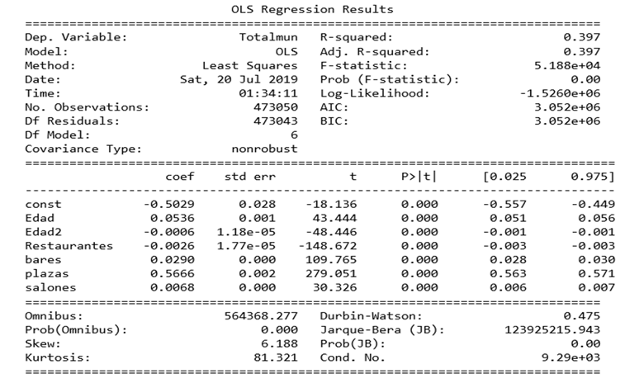

Slide 21
Thanks!

